Slide 1

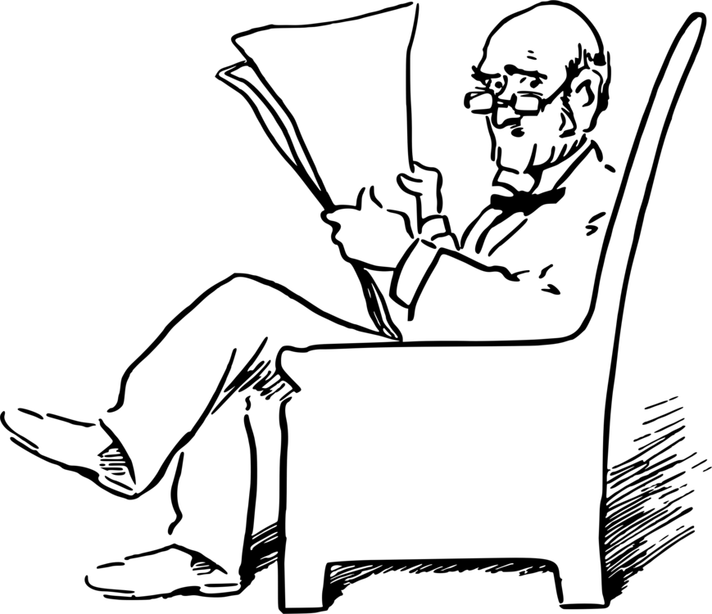
NEWS CLASSIFICATION
INFORMATION RETRIEVAL PROJECT
SUBMITTED BY:
AKHILESH POTHURI
RAHUL GOYAL

Slide 2
WHY NEWS CLASSIFICATION..!!
Nowadays information is available to users through many sources like electronic media, digital media and many more. This data is usually available in the most unstructured form and there exists a lot of ways in which this data may be converted to structured form.
In many real-life scenarios, it is highly desirable to classify the information in an appropriate set of categories. News contents are one of the most important factors that have influence on various sections.

Slide 3
WORKFLOW
PRE PROCESSING AND CLEANING OF RAW DATA
EXPLORING CLEANED TEXT
EXTRACTING CLASSIFIED DATA FROM THE DATASET
FITTING THE MODELS To CLASSIFY

Slide 4
OBJECTIVE
TO CLASSIFY DIFFERENT DATASETS OF NEWS INTO FIVE BROAD CATEGORIES:
BUSINESS
POLITICS
ENTERTAINMENT
SCIENCE- TECHNOLOGY
SPORTS

Slide 5
DATA PREPROCESSING AND CLEANING
1.Removing punctuations, numbers, special characters
2.Removing short words (hmm, ok, oh)
3.Tokenization
4.Stemming

Slide 6
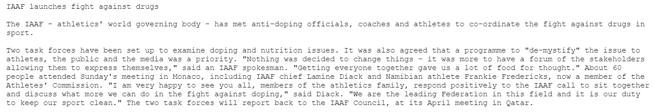
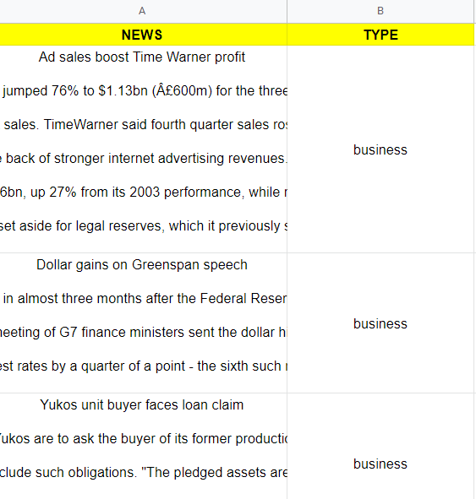
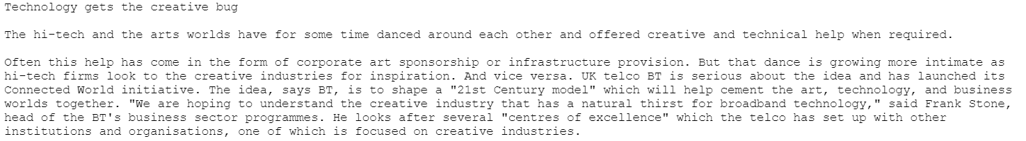
BEFORE
AFTER

Slide 7
EXTRACTING FEATURES FROM CLEANED DATA
BAG OF WORDS FEATURES
TF- IDF FEATURES

Slide 8
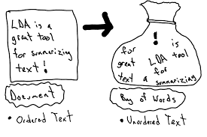
BAG OF WORDS
Bag-of-Words is a method to represent text into numerical features. Consider a corpus (a collection of texts) called C of D documents {d1,d2…..dD} and N unique tokens extracted out of the corpus C.
The N tokens (words) will form a list, and the size of the bag-of-words matrix M will be given by D X N. Each row in the matrix M contains the frequency of tokens in document D(i).

Slide 9
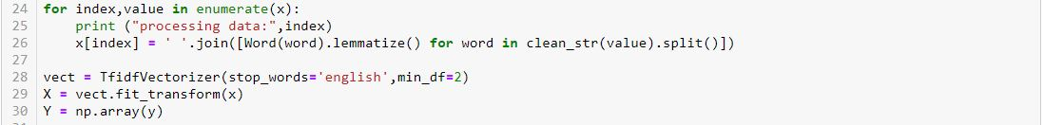
TF- IDF FEATURE
TF-IDF works by penalizing the common words by assigning them lower weights while giving importance to words which are rare in the entire corpus but appear in good numbers in few documents.

Slide 10
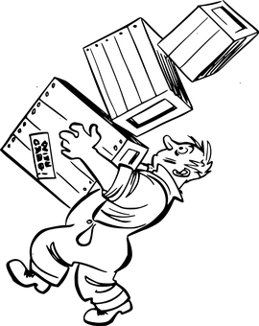
MODEL
RANDOM FOREST
ADA- BOOST CLASSIFIER
GRADIENT BOOST CLASSIFIER

Slide 11
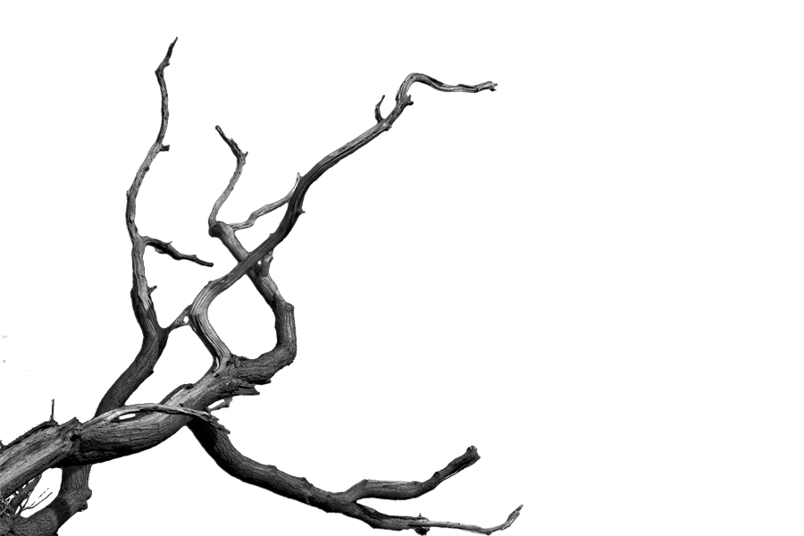
RANDOM FOREST
Random Forest is a supervised learning algorithm. Like you can already see from it’s name, it creates a forest and makes it somehow random. The „forest“ it builds, is an ensemble of Decision Trees, most of the time trained with the “bagging” method.
The general idea of the bagging method is that a combination of learning models increases the overall result.

Slide 12
97.078651

Slide 13
ADA BOOST CLASSIFIER
Ada-boost classifier combines weak classifier algorithm to form strong classifier. A single algorithm may classify the objects poorly. But if we combine multiple classifiers with selection of training set at every iteration and assigning right amount of weight in final voting, we can have good accuracy score for overall classifier.

Slide 14
95.692518

Slide 15
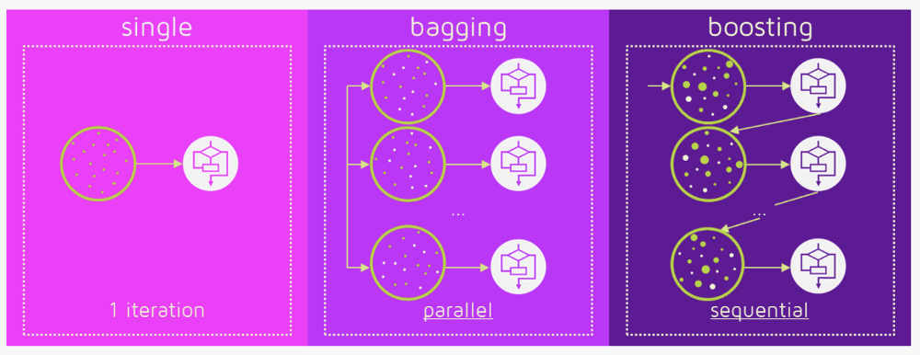
GRADIENT BOOST CLASSIFIER
Gradient boosting is a machine learning technique for regression and classification problems, which produces a prediction model in the form of an ensemble of weak prediction models, typically decision trees.

Slide 16
96.857640

Slide 17
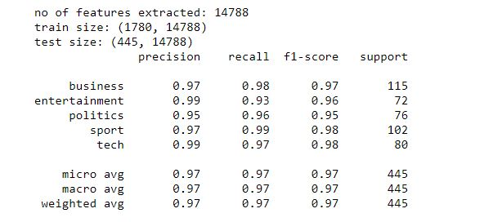
RESULT

Slide 18
THANKYOU

